Slide 1
Sumatra 2004
A brief info-presentation on the Tsunami in 2004

Slide 2
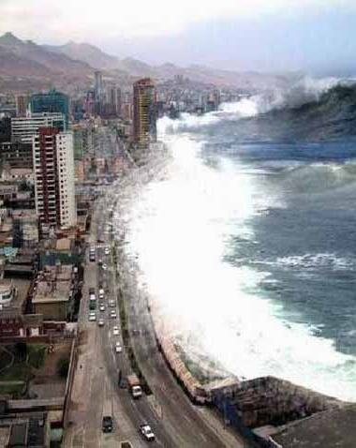
The Background
Caused by an earthquake in the Indian Ocean (9.2 Magnitude)
Series of Tsunamis appeared throughout the coasts of Southeast Asian countries
One of the most deadly acts of nature in history

Slide 3
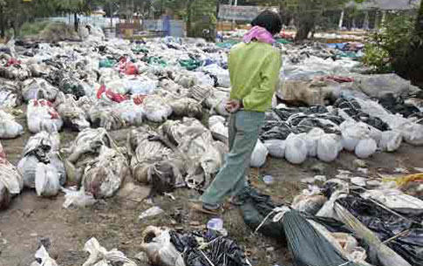
Results
230,000 dead across 14 countries
Over 14 billion (USD) given in humanitarian aid
Entire planet vibrated as much as 1cm causing earthquakes around the world
Leveled many beach resorts and hotels
Environmental impact in reefs and rock formations

