Slide 1
Palestinians & Israel: A Territorial and Inhumane Dispute
Joshua Foster
Final Project

Slide 2
Quote
"For too long, the citizens of the Middle East have lived in the midst of death and fear. The hatred of a few holds the hopes of many hostage. The forces of extremism and terror are attempting to kill progress and peace by killing the innocent. And this casts a dark shadow over an entire region. For the sake of all humanity, things must change in the Middle East.”
- George W. Bush (2002)

Slide 3
Introduction
1948… This was the year the United Nations began to recognise Israel as an independent Jewish state within the Middle East, but what does that really mean? This means that the country will practice and uphold Jewish traditions and religion. As if the Middle East didn’t already have enough conflict on its own, a Jewish state had to rise amidst the chaos. This did not fare well with the neighbouring countries, as they were Arab nations, resulting an in an immediate attack on the newly independent Jewish state. Egypt, Lebanon, Syria & Iraq all attacked Israel on the day of independence, creating worry about the state’s survival. One thing Israel had that these attacking nations didn’t was the ability to make a coordinated attack, and so they did. This led to Israel’s military victories, and as a result of this “War of Independence” and the United Nations, Israel was able to expand its territorial claim further into the Palestinian state. Good for Israel, bad for the native Arabs. This was only the beginning of this ongoing conflict.
In this project, I will address the territorial and ethnicity issues attributing to this conflict through the use of maps, graphs, and analysis of texts.

Slide 4
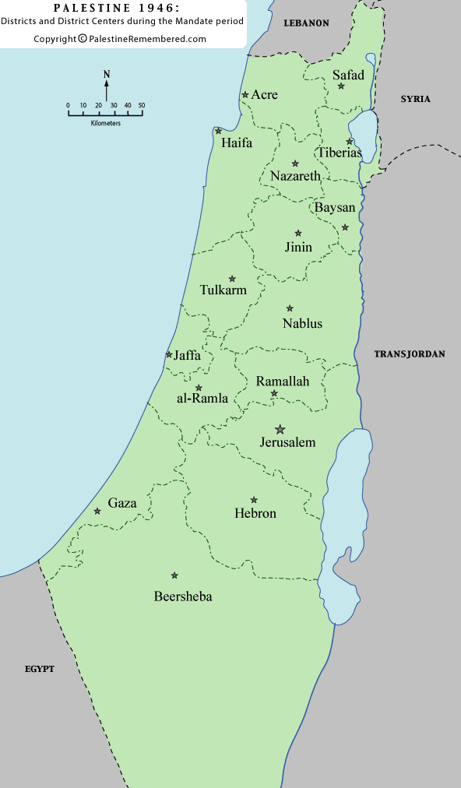
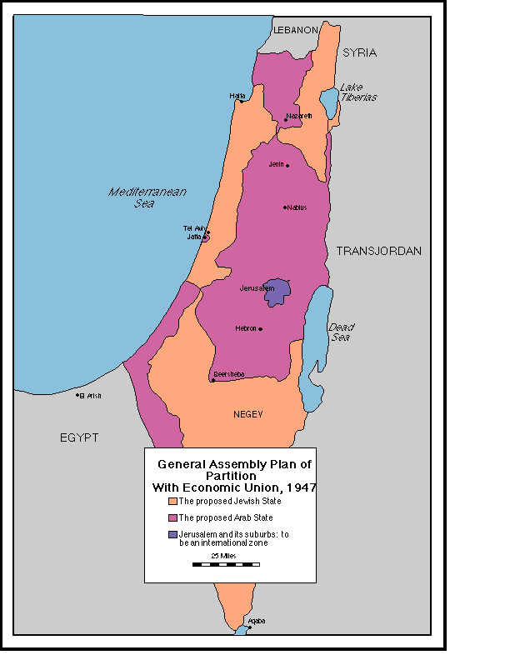
1946 Palestine vs. 1947 Plan for Israel
Notes:
This map shows how the state of Israel was basically created atop already occupied lands.

Slide 5
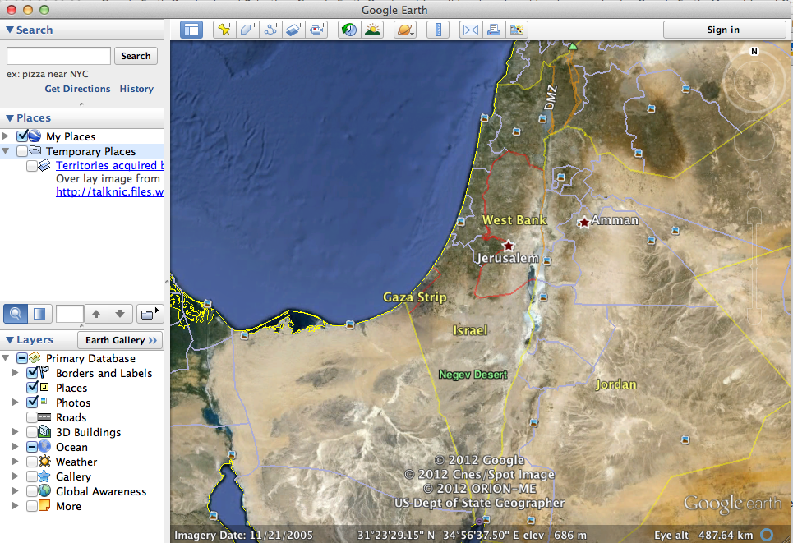
Modern-day Map
Notes:
This map shows Israel as the state it is today.

Slide 6
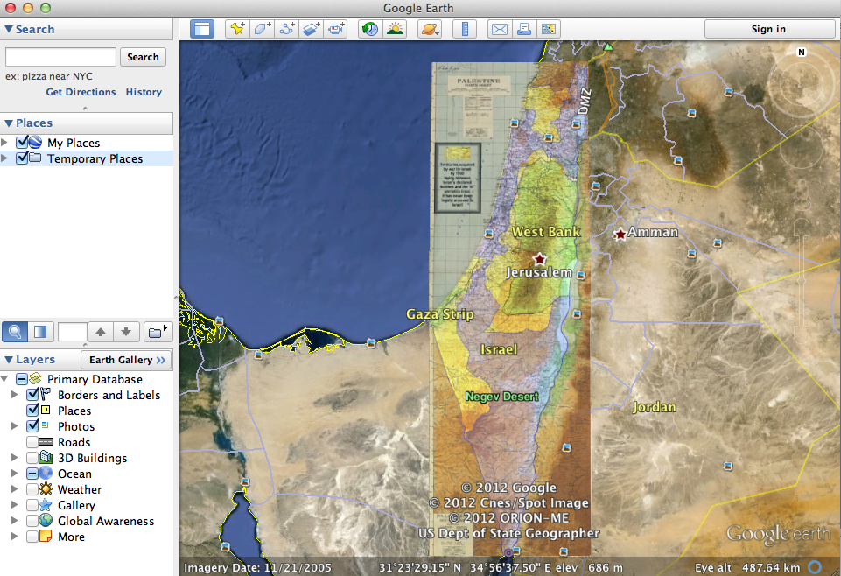
Original Borders of Israel (Overlay)
Notes:
This overlay shows how Israel has expanded its borders over the years into Palestinian lands.

Slide 7
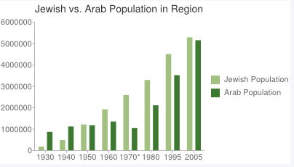
Ethnic Diversity Chart
Notes:
The star at 1970 is an indicator that many Arabs were forced to live as refugees due to the 1967 war. From this chart we can see that the population of Arabs began higher than that of the Israelis but once 1950 hits there is a spike in the Jewish population because of the UN sanctioned declaration of the state of Israel. I feel the UN really began the conflict. Why build a state specifically targeted for Jewish people while there is a big population of Arabs already present?

Slide 8
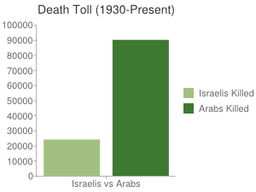
Death Toll
Notes:
Clearly, the side that has a more full support of the UN has resulted in less deaths. This is a result of what happens when land is partitioned from one completely different group on top of an already populated region.

Slide 9
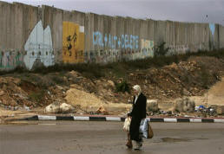
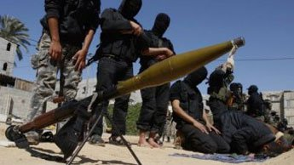
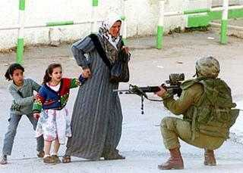
Photos

Slide 10
Analysis of Text
Rowley, Charles. “The Israel and Palestine Land Settlement Problem, 1948-2005: An Analytical History.” Public
Choice 128 (2006): 77-90. Print.
This article in the journal really offers some insight on one of the main reasons this conflict continues to blossom in the Middle East. Land settlement disputes occur every day here. As seen in my overlay map from earlier Israel has expanded on its own beyond its boundaries causing people to seek refuge elsewhere due to religious differences. One of the key reasons Israel was able to expand without being questioned was the Six Day War which resulted in Israel gaining control of Gaza and the West Bank, which caused much indifference because both of these lands are home a big Arab population. Israel eventually loosened ties allowing them to somewhat govern themselves, which is why we have the terrorist group, Hamas, in power in the Gaza Strip. After reading the article I believe that a key attributing factor to the ongoing conflict is the leadership within this region. Gaza cannot maintain on its own so Hamas takes control of the governing body. Hamas has stated multiple times that it will not be an ally of the Israelis and that one of its goals is to destroy them. With a stronger governing body I believe Gaza would be able to reduce the conflict with Israel and possibly proceed into negotiations for peace with the absence of Hamas. It will be very interesting to see what is to come as a result of the recent UN announcement that there shall be a formation of a Palestinian state. This may just have enough influence to lessen the conflict between both. In the world today, there is no way to fully obtain peace, especially between two groups that are so different socially and religiously and for that reason attributing factors to the conflict must be eliminated in order to lessen this forever-lasting conflict.

Slide 11
Analysis of Text
Elazar, Daniel. “Israel as a Jewish State.” Jerusalem Center for Public Affairs (2009). Online.
This text is most definitely very informative on why Israel acts the way it does. In the section “Israel as a Politically Independent State” the governmental set up was addressed and the way it functions. It is very similar to the United States, but the question is why can’t they find peace as the US has with many countries? This is because, like the Palestinians, they have radical beliefs that impact their decisions. This counter acts the Arab residents of the region and their radical beliefs that there shouldn’t be an existence of Jewish people. Another thing I found interesting is that Israel is one of the only democratic states in the region besides Turkey, but Turkey does not have much influence in the Israel-Palestine conflict. For this reason Israel always receives the full support of the United States which causes the Palestinians to believe they are targets. This is a cause of conflict because targets often react causing the Palestinians to retaliate or even initiate every time there is a possible threat of an attack. We may all continue asking the question of why can’t there be peace in the Middle East for years to come. This conflict is nowhere near ending due to the many differences between these two groups. Temporary peace may be a possibility now as long as the Hamas drops from power in the territories surrounding Israel. In all, the state of Israel and the Palestinians will always have problems and the conflict will never fully be over.

Slide 12
The End
Thank You

